Slide 1
Identifying, Understanding and Deconstructing Colonial Narratives within Medicine and Health
Odein Princewill

Slide 2
Identifying Colonial Narratives within Medicine and Health
Colonisation entails the control, domination and subjugation of one power, usually a foreign entity over another autonomous territory or people.
Decolonisation is the pursuit of redressing colonial practises and pursuing knowledge that transcends colonial influences.
Post-colonisation refers to the period of time after decolonisation has occurred.
Neo-colonisation exists within the post-colonial era and as its name suggests refers to a new form of colonisation.

Slide 3
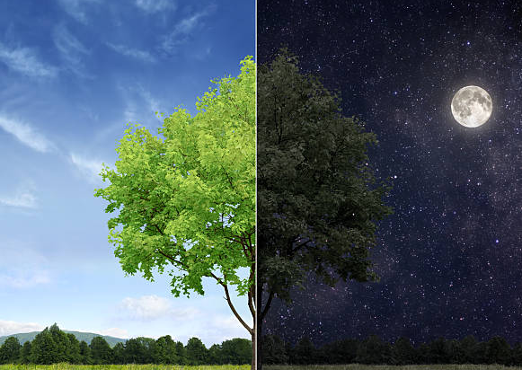
Identifying Colonial Narratives within Medicine and Health
Race refers to the concept of dividing people into groups on the basis of various sets of physical characteristics and the process of ascribing social meaning to those groups.
Ethnicity describes the culture of people in a given geographic region, including their language, heritage, religion and customs.

Slide 4
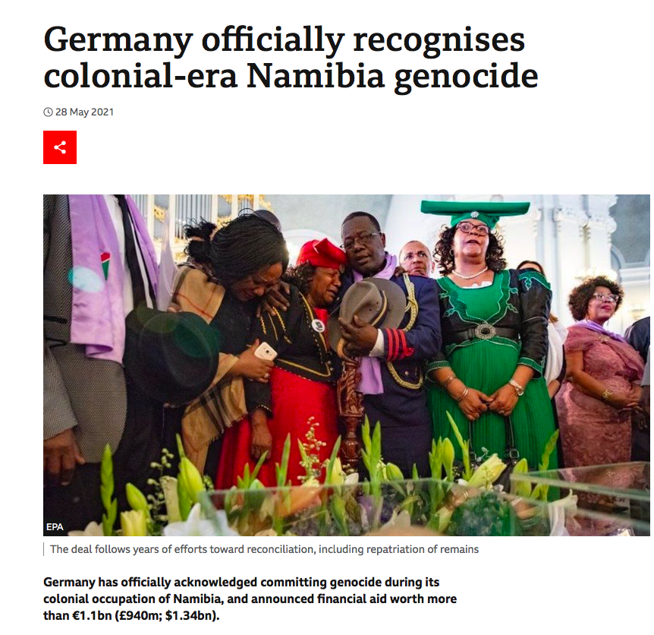
Understanding Colonial Narratives within Medicine and Health
Eugenics, Scientific Racism, Social-Darwinism, Pseudo-Sciences……
Eugenics refers to using pseudo-science to promote racial purity and planned breeding. It is a concept rooted in social Darwinism , which in itself promoted the idea of ‘survival of the fittest’ which was the idea that certain people become powerful in society because they are innately better.

Slide 5
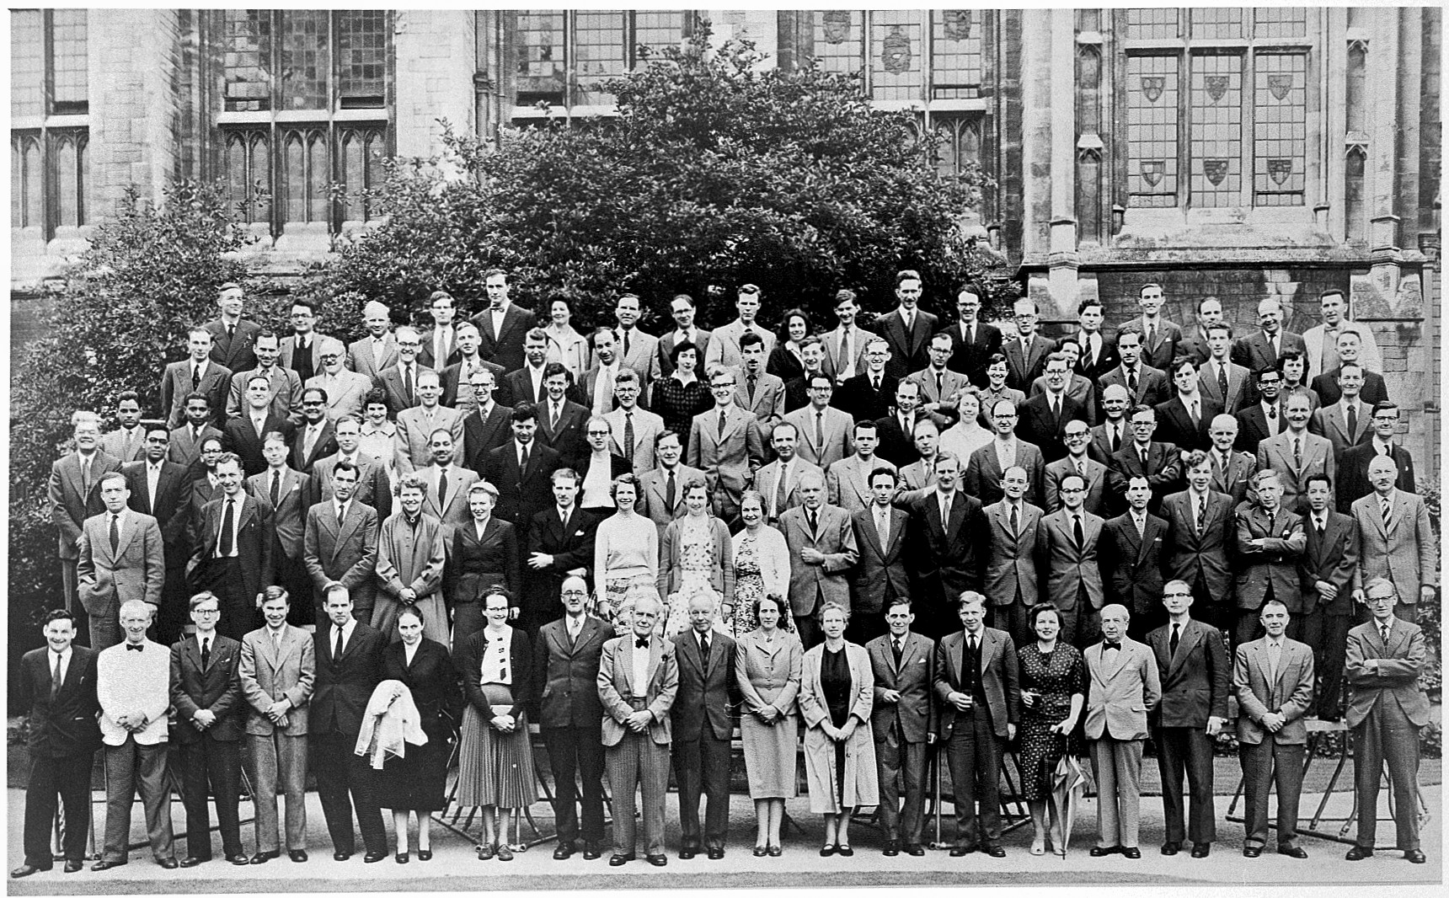
”

Slide 6
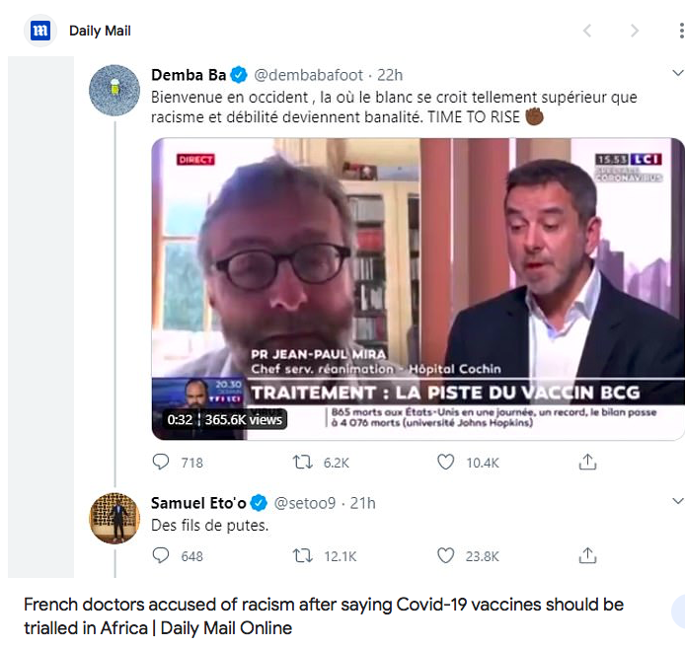

Slide 7
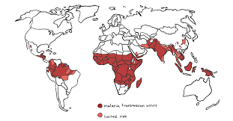
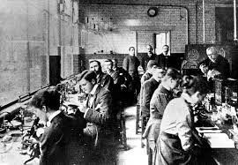
The Royal Society of Tropical Medicine and Hygiene
“dedicated to global health since 1907”
“interdisciplinary branch of medicine that deals with health issues that occur uniquely, are more widespread, or are more difficult to control in tropical and subtropical regions”.

Slide 8
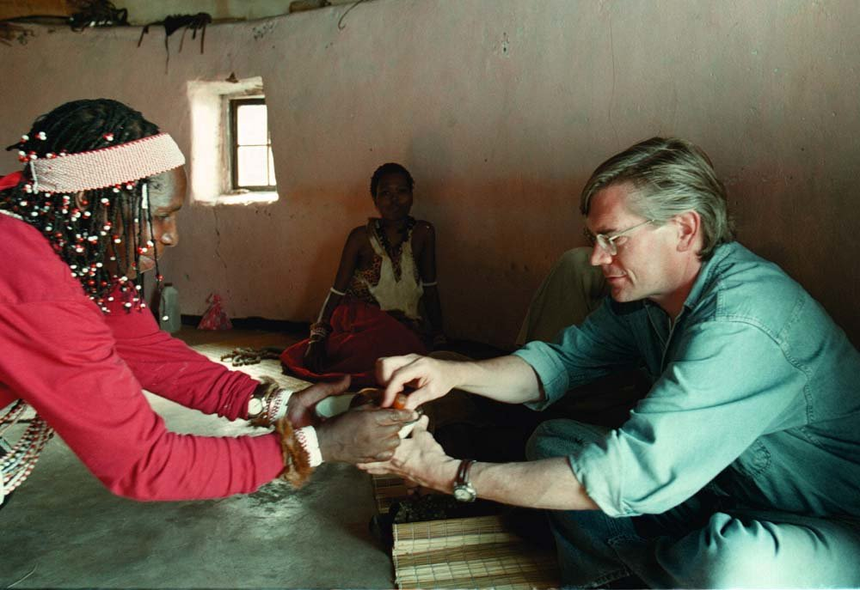
Traditional Medicine
The introduction of Western medicine and culture gave rise to a ‘cultural-ideological clash’ which created an unequal power-relation that practically undermined and stigmatised the traditional health care systems.
The institutionalisation of the modern health care system can be seen as one of the many ‘legacies’ of Western encroachment in Africa, even when yielding positive results.

Slide 9
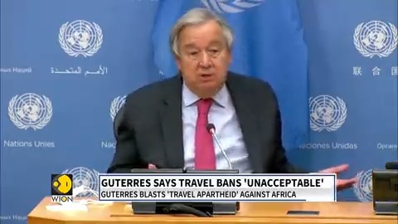
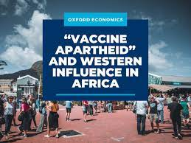
Race Relations within International Healthcare
The Harmful Undertones of the UK’s Travel Restriction Red List: European countries that detected the omicron variant within their population were excused from the red list; while South Africa, the country that informed the global community on the variant was placed on the red list despite already taking measures to respond to the variant ahead of the UK and other European nations.

Slide 10
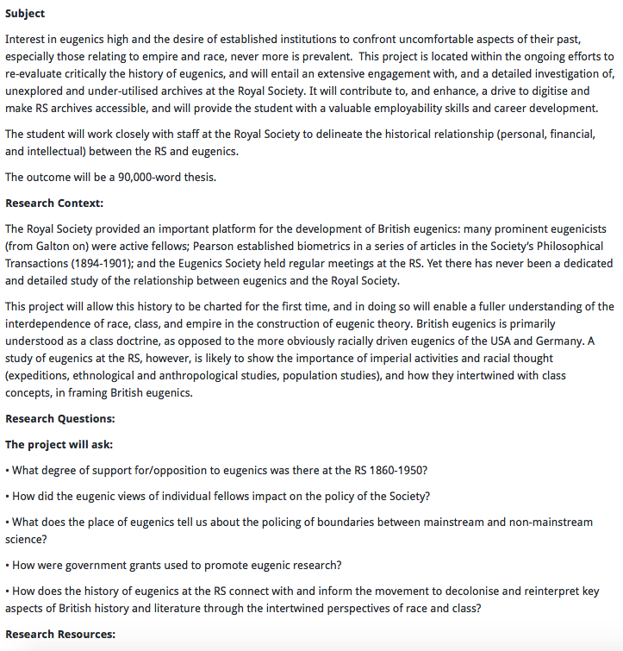
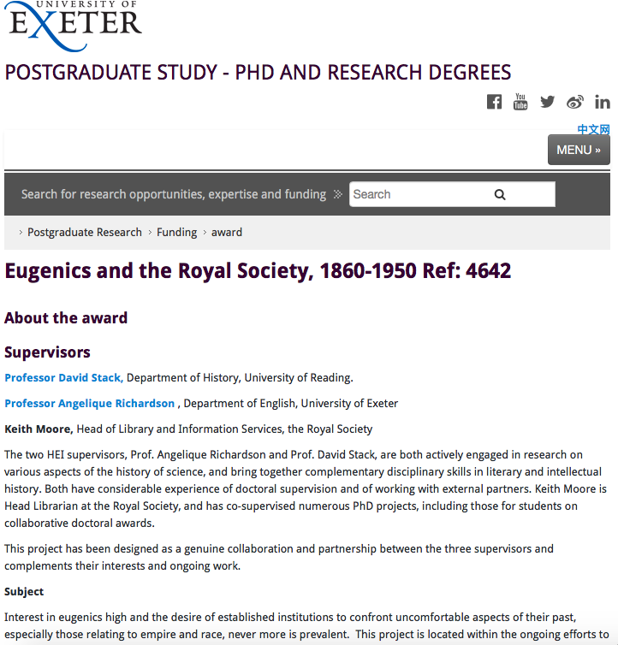
Deconstructing Colonial Narratives within Medicine and Health

Slide 11
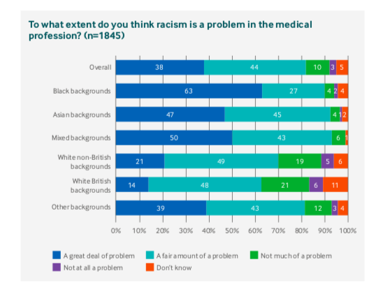
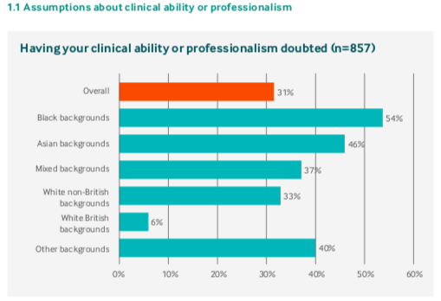
Findings of the British Medical Association Racism in Medicine Survey (2022)

Slide 12
Discussion Questions
There is evidence to suggest that simply living as a person of colour can result in poor health. How might discrimination in education, economy, and housing create a perfect storm for discrimination in healthcare?
Racial discrimination can come as a result of medical training. How would you work to improve training of medical professionals to decrease levels of discrimination in healthcare settings? What do you think is the most important training that is required?
Taken from: The Matrix of Race: Social Construction, Intersectionality and Inequality by Rodney D. Coates, Abby L. Ferber and David L. Brunsma

Slide 13
Thank You!
LinkedIn: Odein Princewill
Email: od.princewill@gmail.com

